Slide 1
Constraining self-propagating malicious software at end-hosts
529 Debate
Affirmative Team:
Adriana Flores and Clayton Shepard

Slide 2
Background
Worm= Self-replicating computer program that is self-contained and does not need to be part of another program to propagate itself.
4 parts:
Vulnerability that it uses to infect computers
Propagation method, or how it chooses its next target
Random, Limited, Topological, Hit List
Payload, or what it does to an infected computer
Intended goal, steal information or target shutdown
Protect: Anti-virus, anti-sypware, firewall
Notes:
Is a self-replicating computer program,
similar to a computer virus but unlike a
virus which attaches itself to, and becomes
part of, another executable program, a worm
is self-contained and does not need to be
part of another program to propagate itself.
-The infection is dependent on the targeted computer having the specific vulnerability that the
worm uses.
-Worms spread by exploiting vulnerabilities in operating systems

Slide 3
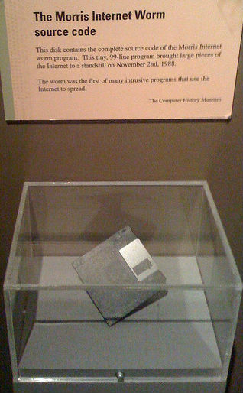
Worm History
Xerox PARC- John Shoch
“Tape worm” - The Shockwave Rider.
PhD analysis of traffic patterns
Christma Exec - German EARN network (1987)
Bitnet connections to wreak havoc on the IBM Internal File Transfer Network in the US
Christmas tree in terminal and mailed itself and erased itself
Morris worm (1988) ~ $10 million to $100 million
Exploited weak passwords along with known vulnerabilities
Re-infect individual servers multiple times
World’s first Internet denial of service (DoS) attack.
Infected ~ 6,000 servers or 10% of the servers on the Internet
Notes:
Shoch's doctoral
research was an analysis of the traffic
patterns of PARC's Ethernet (another PARC
first) that linked 200 of its "Altos," personal
computers.
His idea was to arrange for
about 100 of the machines to spew bits into
the Ethernet simultaneously, then measure
the ensuing electronic gridlock. ("Benefits,"
n.d) Rather than loading the same program
individually into every machine, he devised
the worm to do the loading automatically by
seeking out idle Altos computers and
transmitting the test program by wire to
those that signaled they were available.
Christma Exec required the user to execute an innocent
looking script that was attached to an E-mail
message
Christmas tree to
appear on the terminal and then it mailed
itself to everyone on the user's NAMES file
including any distribution lists.
“Multi Mode” worm that attacked DEC VAX servers running Sun and BSD operating systems
Is a self-replicating computer program,
similar to a computer virus but unlike a
virus which attaches itself to, and becomes
part of, another executable program, a worm
is self-contained and does not need to be
part of another program to propagate itself.
Morris worm exploited weak passwords along
with known vulnerabilities in the send mail
application and Unix utilities fingerd and
rsh/rexec.
I love you , overwrote files – impossible to recover, hide mp3 files, downloaded trojan horse make user names and passwords available to virus author

Slide 4
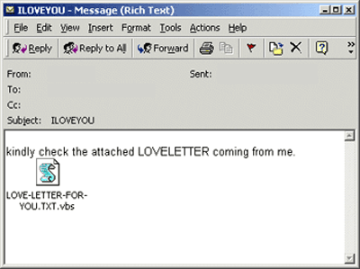
Worm History
I LOVE YOU (2000) ~$8.75 billion
Microsoft Outlook e-mail address book
Malicious
Overwrite files, hide MP3 files, downloaded Trojan horse to steal names and passwords
Code Red (2001) ~$2.6 billion
Vulnerability in Microsoft's Internet Information Server (IIS)
Complete command line control
Waited 20-27 days to launch DoS attacks against the White House’s IP address
359,000 servers in just 14 hours
Peak: 2,000 servers per minute
Future: more complex worms might incorporate sophisticated polymorphic, and metamorphic behavior routines that will make use of entry-point obscuration [1]
Notes:
Shoch's doctoral
research was an analysis of the traffic
patterns of PARC's Ethernet (another PARC
first) that linked 200 of its "Altos," personal
computers.
His idea was to arrange for
about 100 of the machines to spew bits into
the Ethernet simultaneously, then measure
the ensuing electronic gridlock. ("Benefits,"
n.d) Rather than loading the same program
individually into every machine, he devised
the worm to do the loading automatically by
seeking out idle Altos computers and
transmitting the test program by wire to
those that signaled they were available.
Christma Exec required the user to execute an innocent
looking script that was attached to an E-mail
message
Christmas tree to
appear on the terminal and then it mailed
itself to everyone on the user's NAMES file
including any distribution lists.
Melissa (1999) ~ $1.1 billion
Is a self-replicating computer program,
similar to a computer virus but unlike a
virus which attaches itself to, and becomes
part of, another executable program, a worm
is self-contained and does not need to be
part of another program to propagate itself.
Morris worm exploited weak passwords along
with known vulnerabilities in the send mail
application and Unix utilities fingerd and
rsh/rexec.
I love you , overwrote files – impossible to recover, hide mp3 files, downloaded trojan horse make user names and passwords available to virus author

Slide 5
Problem
Self-propagating malware (worms) are able to compromise vulnerable end-hosts and leverage these to perpetuate themselves
Self-propagating malware (worms) are able to compromise the network due to vulnerabilities in end-hosts
To solve this problem, do we need secured end-hosts or the network?
Do we need secured end-hosts or the network?

Slide 6
Prior Work: “Secure” the network
Detecting abnormal communication patterns
Blocking or rate limiting traffic from hosts that exhibit abnormal communication patterns
Williamson [2], Snort [3], Network Security Monitor [4]
Can’t contain worms that have normal traffic patterns
E.g. topological worms and slow-spreading worms
→ False positives
Content signatures
Signatures for unknown worms, identify a common byte string in suspicious network flows [5,6,7]
Absence of information about software vulnerability
→ False positives
Notes:
[2] – limit rates to new connections
3 and 4 – monitor rate at which unique destination addresses are contacted and block sender

Slide 7
Prior Work: Secured hosts
Host-based architecture
Vigilante [8] hosts protect themselves automatically by generating filters
Central service with heuristics to modify vulnerable source code [9]
Memory monitoring and management [10-12]
Checks for illegal memory access
Check for overwrites and apply rollbacks
Filters
IntroVit [13] , vulnerability-specific predicates run inside virtual machines
Shield [14], manually deployed host-based filters to block vulnerabilities
Allow vulnerable services to continue execution while being attacked

Slide 8
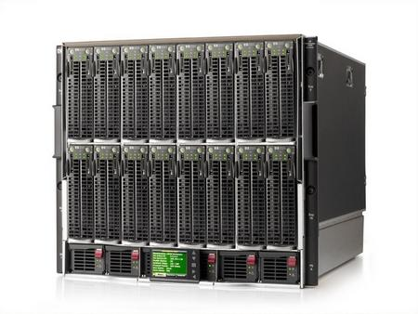




Networks goal
Notes:
- The purpose of a network is to enable communication, not ensure security
- Networks *can* control who talks to who (and how they talk), i.e. access control, but they *cannot* ensure security

Slide 9
Networks goal
Communication
Notes:
- The purpose of a network is to enable communication, not ensure security
- Networks *can* control who talks to who (and how they talk), i.e. access control, but they *cannot* ensure security

Slide 10
Networks goal
Communication
Security
Notes:
- The purpose of a network is to enable communication, not ensure security
- Networks *can* control who talks to who (and how they talk), i.e. access control, but they *cannot* ensure security

Slide 11
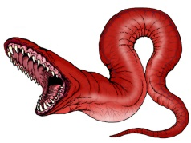
Self-propagating Malware in Networks
Notes:
- A network that detects (and mitigates/blocks) malware is no longer just a network. (The detection part can be considered a computer or even a host that controls the network.)

Slide 12

Detecting Malware in Networks
Notes:
A network that detects (and mitigates/blocks) malware is no longer just a network. (The detection part can be considered a computer or even a host that controls the network.)
- As long as there is communication there can be a security hole.
- The only way to make a network perfectly "secure" is to block all communication. (Whereas a a secure host can exist on any network without any risk of infection.)

Slide 13
Defeated Network Purpose
No Communication
Notes:
A network that detects (and mitigates/blocks) malware is no longer just a network. (The detection part can be considered a computer or even a host that controls the network.)
- As long as there is communication there can be a security hole.
- The only way to make a network perfectly "secure" is to block all communication. (Whereas a a secure host can exist on any network without any risk of infection.)

Slide 14
Security hole vs. Communication
Notes:
A network that detects (and mitigates/blocks) malware is no longer just a network. (The detection part can be considered a computer or even a host that controls the network.)
- As long as there is communication there can be a security hole.
- The only way to make a network perfectly "secure" is to block all communication. (Whereas a a secure host can exist on any network without any risk of infection.)

Slide 15
Summary End-host protection
Advantages:
Can exists in any network without risk of infection
Vulnerabilities can be known by end host only
Disadvantages:

Slide 16
Summary “Secured” network
Advantages:
Disadvantages:
False Negatives

Slide 17
Summary

Slide 18
References
[1] Fosnock, Craig. "Computer worms: past, present, and future." East Carolina University 8 (2005).
[2] Williamson, Matthew M. "Throttling viruses: Restricting propagation to defeat malicious mobile code." Computer Security Applications Conference, 2002. Proceedings. 18th Annual. IEEE, 2002.
[3] Roesch, Martin. "Snort: Lightweight Intrusion Detection for Networks." LISA. Vol. 99. 1999.
[4] Heberlein, L. Todd, et al. "A network security monitor." Research in Security and Privacy, 1990. Proceedings., 1990 IEEE Computer Society Symposium on. IEEE, 1990.
[5] Kreibich, Christian, and Jon Crowcroft. "Honeycomb: creating intrusion detection signatures using honeypots." ACM SIGCOMM Computer Communication Review 34.1 (2004): 51-56.
[6] Kim, Hyang-Ah, and Brad Karp. "Autograph: Toward Automated, Distributed Worm Signature Detection." USENIX security symposium. Vol. 286. 2004.
[7] Singh, Sumeet, et al. "Automated Worm Fingerprinting." OSDI. Vol. 4. 2004.

Slide 19
References
[8] Costa, Manuel, et al. "Vigilante: End-to-end containment of internet worms." ACM SIGOPS Operating Systems Review. Vol. 39. No. 5. ACM, 2005.
[9] Sidiroglou, Stelios, and Angelos D. Keromytis. "Countering network worms through automatic patch generation." (2003).
[10] Sidiroglou, Stelios, et al. "Building a reactive immune system for software services." Proceedings of the general track, 2005 USENIX annual technical conference: April 10-15, 2005, Anaheim, CA, USA. USENIX, 2005.
[11] Rinard, Martin C., et al. "Enhancing Server Availability and Security Through Failure-Oblivious Computing." OSDI. Vol. 4. 2004.
[12] Smirnov, Alexey, and Tzi-cker Chiueh. "DIRA: Automatic Detection, Identification and Repair of Control-Hijacking Attacks." NDSS. 2005.
[13] Joshi, Ashlesha, et al. "Detecting past and present intrusions through vulnerability-specific predicates." ACM SIGOPS Operating Systems Review. Vol. 39. No. 5. ACM, 2005.
[14] Wang, Helen J., et al. "Shield: Vulnerability-driven network filters for preventing known vulnerability exploits." ACM SIGCOMM Computer Communication Review. Vol. 34. No. 4. ACM, 2004.

Slide 20
Extras

Slide 21
Prior Work: Secure hosts
Host-based architecture
Vigilante [8] hosts protect themselves automatically by generating filters
Central service with heuristics to modify vulnerable source code [36]
Memory monitoring and management [37,34,39]
Checks for illegal memory access
Check for overwrites of control data structures with rollbacks
Filters
IntroVit [7] , vulnerability-specific predicates run inside virtual machines
Shield [45], manually deployed host-based filters to block vulnerabilities
Allow vulnerable services to continue execution while being attacked
Host base detection of vulnerabilities

